Slide 1
NET: standard of care and future perspectives
Dr Nidal KHEDER
Head of Oncology department
Ibn alnafis Hospital – Damascus
08-12-2022

Slide 3
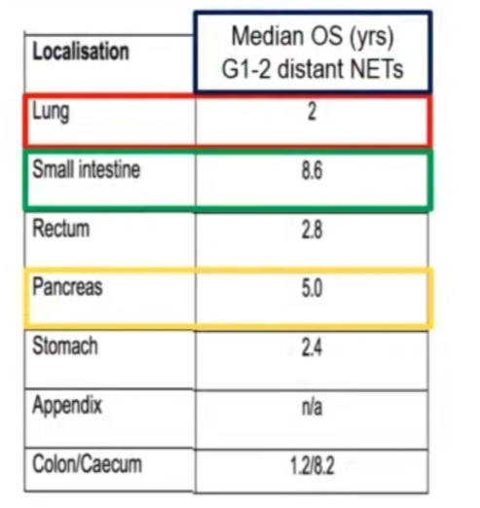

Slide 25
Thank you for your attention

